Slide 1


What is the optimal fin shape for an air-powered rocket?
Yuhan Wu
Notes:
Hello everyone!
My name is Michelle and my capstone project topic is what is the optimal fin shape for an air-powered rocket?

Slide 2


Part 1 Intro & Why part 2 details and results part 3 conclusion and takeaways
Notes:
My presentation is in three parts:
The first part is introduction of my project and the reason why I chose it.
The second part is about some details of my project and the final result I got.
The third part is about the conclusion and takeaways.

Slide 3



Why about air-powered rocket?
This project is about building and testing rocket models with different fin shapes to see which fin shape gives the best speed and stability.
This project relates to my favorite subjects: math and science.
Rocket club at school.
Computing skills involved also attract me.
My academic goal is to become a computer engineer and this air-powered rocket project can help me gain experience and further explore this field.
Notes:
This project is about
building and testing rocket models with
different fin shapes to see which fin shape gives the best speed and stability.
Academic aspiration -- computer engineer
this air-powered rocket project can help me gain experience and further explore this field
Which requires Computing skills and problem-solving ability.
Favorite subjects
Rocket club at school.

Slide 4

Part 2 Details and Results
Step 1: Research & gather information
Step 2: Online design/build models
Step 3: 3-D print and launch
Notes:
It took me 3 steps to complete part two
Step 1: Research & gather information
Step 2: Online design/build models
Step 3: 3-D print and launch

Slide 5
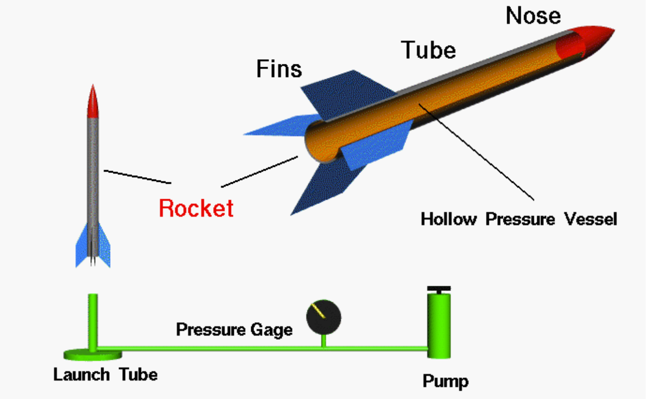
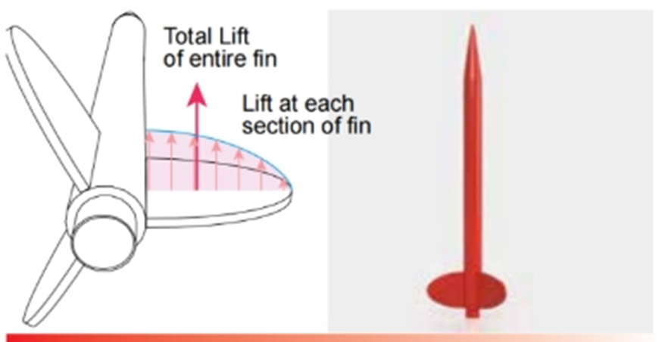
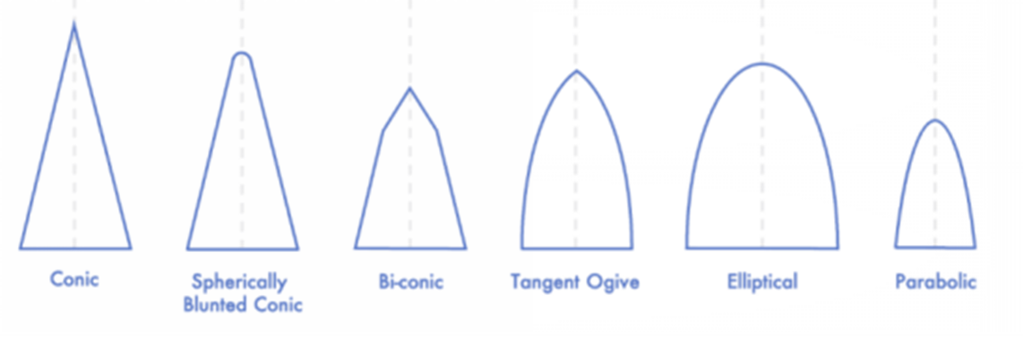
Step 1: research
I learned about
the components of a rocket;
the four forces acting on a rocket;
the different shapes of fins & nose cones
Rocket aerodynamics — Science Learning Hub
Model Rocket Fins 101: Purpose, Shape, Size, and Placement – The Model Rocket
What size should rocket fins be (ratio, formula, etc.)? – Quora
Technical Publication 16 - What Type of Fin Shape is Best : Apogee Rockets, Model Rocketry Excitement Starts Here
My prediction:
Elliptical fins can provide a rocket with the best speed and stability
Notes:
I did my research on rocket components and their functions; aerodynamic forces and different shapes of components.
After watching videos, reading magazines and articles I made my prediction

Slide 6

Step 2 online design/build models
Apps used: Autodesk Fusion 360, Open Rocket
Discuss with and learn from the Rocket Club members.
Try-and-error, and problem solving.
Notes:
This part is the most challenging part of my project because I needed to learn new knowledge in a unfamiliar field by self-learning and peer learning.

Slide 7
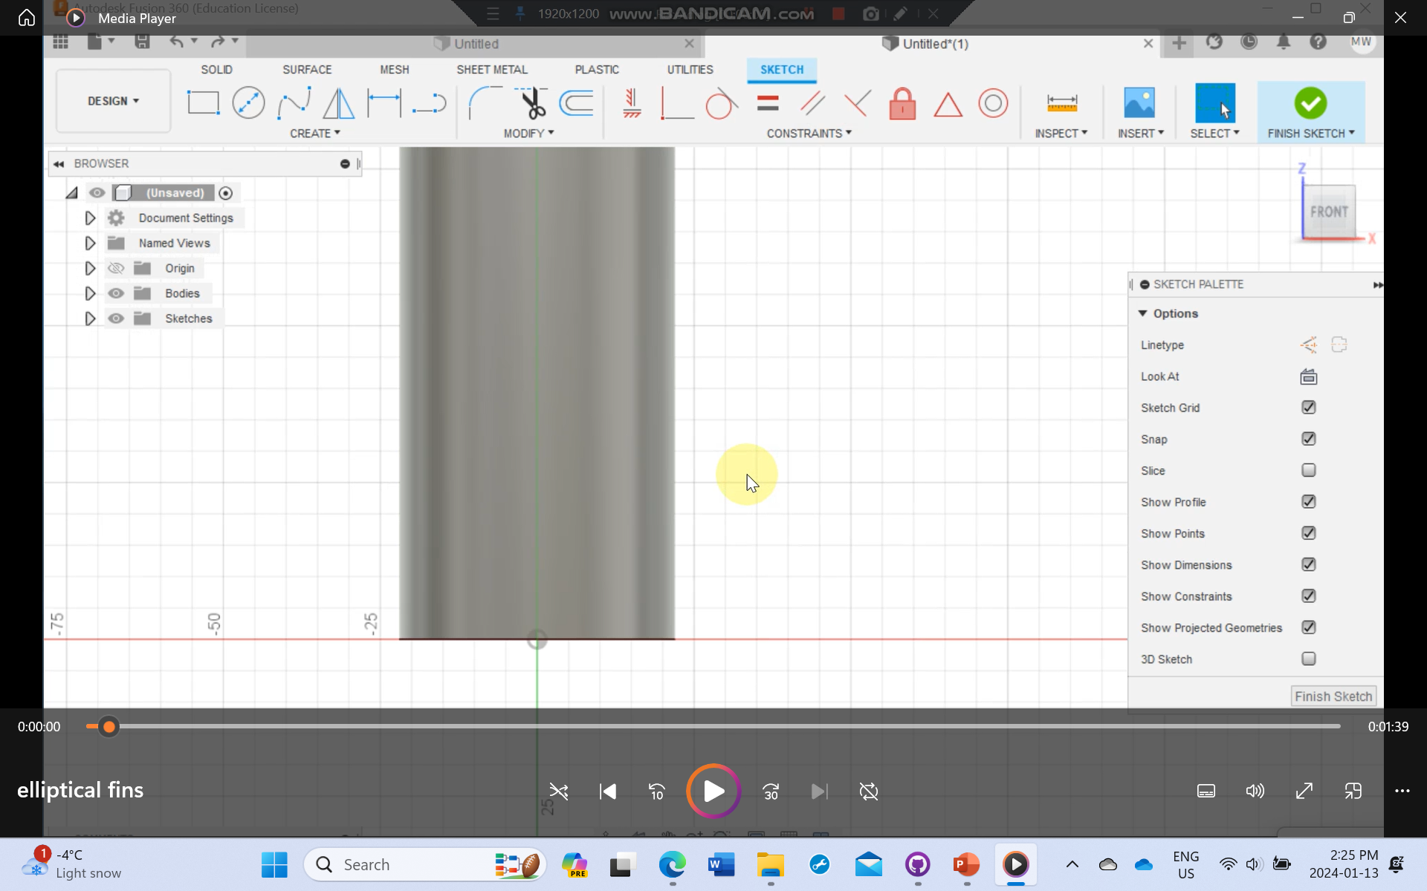
Elliptical Fins video link
Notes:
This is a video of how I design elliptical fins for my rocket by using Autodesk Fusion 360.
I first use the line tools and the ellipse tool to design one fin, and then use the extrude tool to turn it from one-dimensional to three-dimensional.
Finally I used the pattern tool and select the body as the axis, and four identical fins just show up surrounding the body tube.

Slide 8
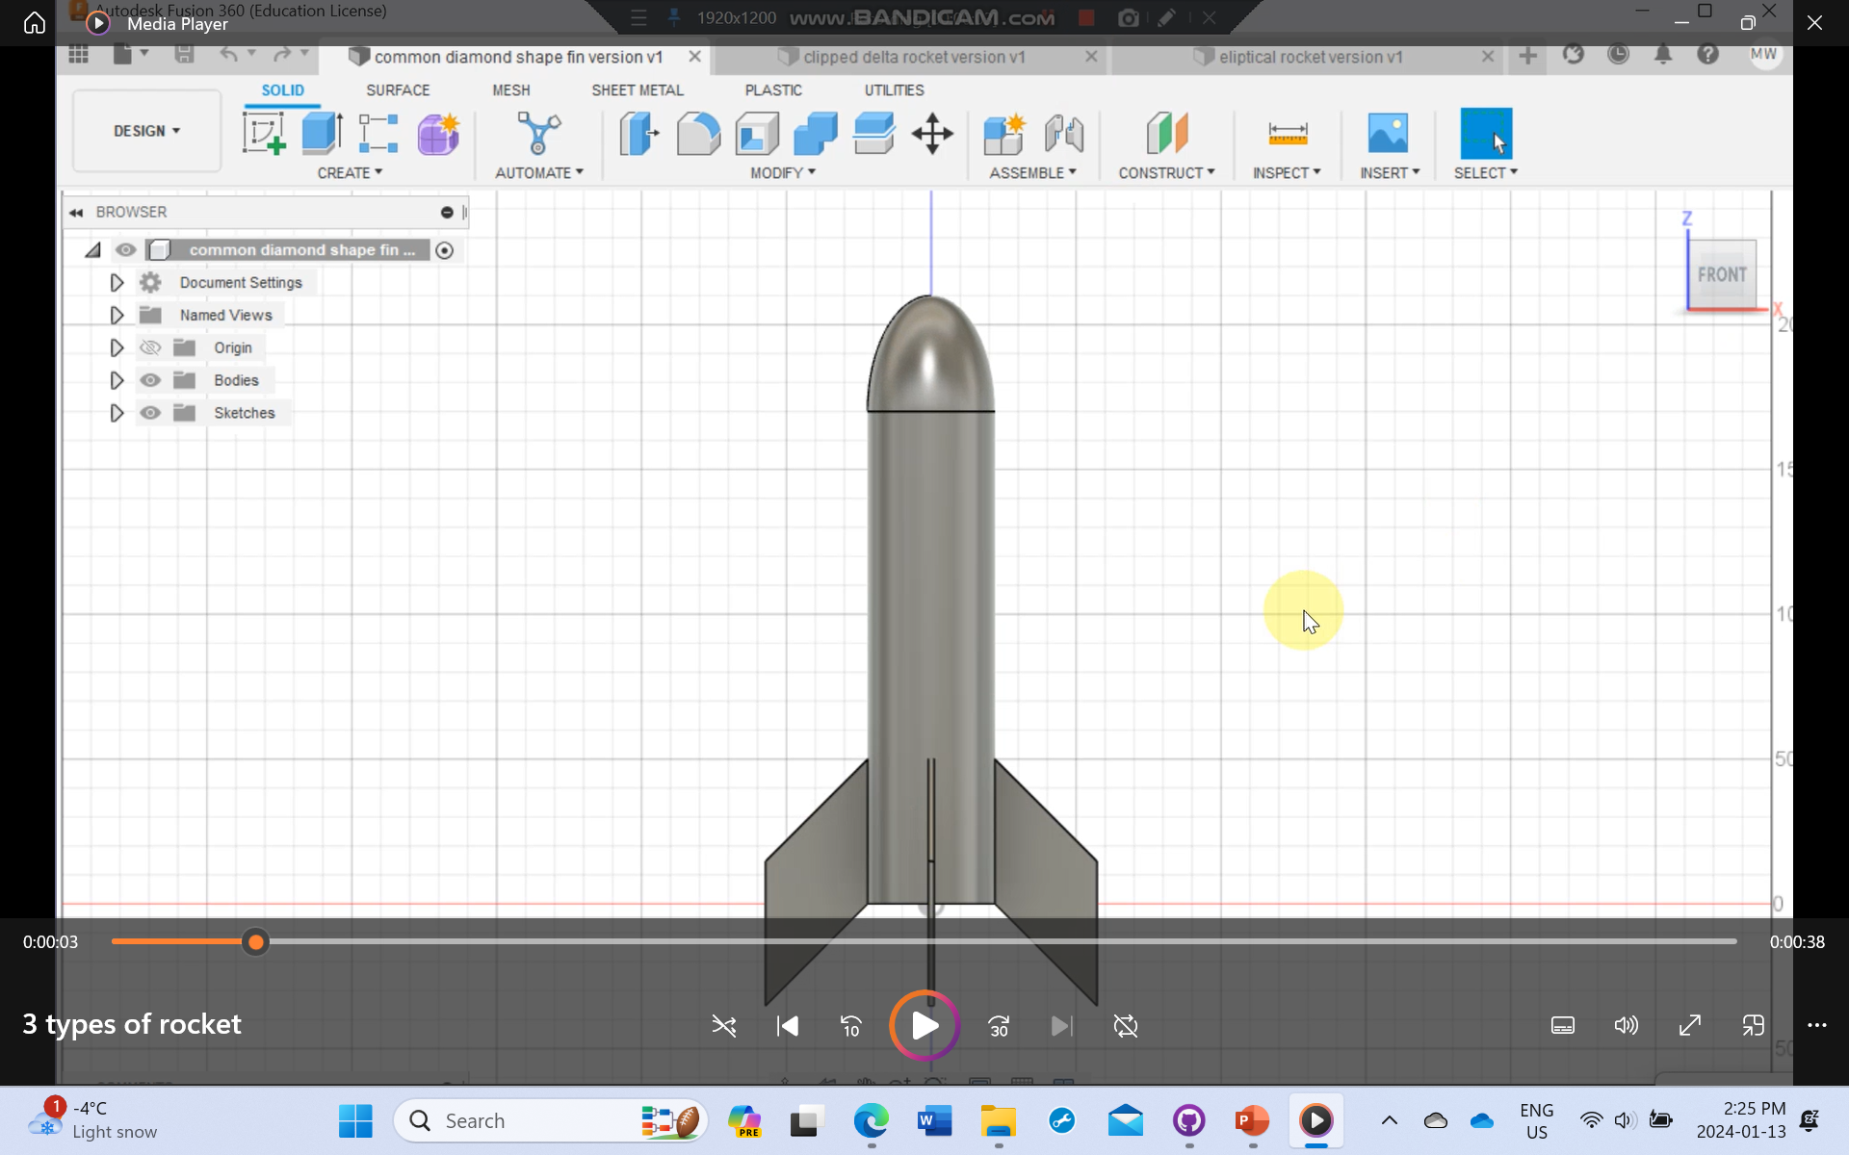
Three designs of different fin-shaped rockets video link
Notes:
So these are three rocket designs with different types of fins.
The first one has common diamond-shaped fins
The second one is the clipped delta fin shape
The third one is theoretically the best fin-shaped rocket– the elliptical fins.

Slide 9

Result & Conclusion
I have completed the researching and online designing part.
Unfortunately, due to some technical issues, the 3-D printer at school didn’t work well, so I couldn’t print out a physical copy and use an air-pump to test the models and to give a conclusion of which fin shape is the best fit for a rocket.
Notes:
I have completed the researching and online designing part.
Unfortunately, due to some technical issues, the 3-D printer at school didn’t work well, so I couldn’t print out a physical copy and use an air-pump to test the models and to give a conclusion of which fin shape is the best fit for a rocket.

Slide 10

Takeaways
Challenges and setbacks:
The complicated concepts involved in research
The setbacks when approaching to build rocket model
The struggle to make 3D printing work – with unfortunately hasn’t been achieved
I learned that challenges and difficulties are required to approach something new.
Problem-solving ability is very important as there will always be some unexpected problems appearing in your journey of exploring.
Notes:
So this project inspires me to always have a plan B for anything I am trying and achieve. I learned to let go of the anxiety when facing challenges but to explore other methods of solving with a cheerful attitude. Also, peer learning and cooperating with other team members can be really helpful to achieve your goal.

